Slide 1

Data Structures in Python

Slide 2

Agenda
Introduction to Graph Optimization
Dijkstra’s Algorithm
Bellman–Ford Algorithm
Topological Sorting (DAG)
Minimum Spanning Tree (Prim’s Algorithm)
Minimum Spanning Tree (Kruskal’s Algorithm)
Introduction to Network Flow
Applications and examples

Slide 3
Unit Overview
This unit introduces graph optimization algorithms used to find the best paths and minimum cost connections in graphs. Students will learn shortest path algorithms like Dijkstra’s and Bellman–Ford, and techniques to connect all nodes efficiently using Minimum Spanning Tree algorithms such as Prim’s and Kruskal’s.
The unit also covers Topological Sorting for task scheduling and introduces Network Flow concepts used in real-world systems like transportation and communication networks.
These algorithms are essential for solving real-world problems involving routing, scheduling, and network optimization.

Slide 4
Introduction to Graph Optimization
Graph Optimization algorithms are used to find the best path or best structure in a graph.
These algorithms help solve problems like:
Shortest path between cities
Minimum cost network connection
Task scheduling
Network routing

Slide 5
Dijkstra’s Algorithm
Dijkstra’s Algorithm finds the shortest path from one source vertex to all other vertices in a weighted graph.
Works only with positive weights.
Example Graph
(4)
A ---- B
| |
(2)| (5)
| |
C ---- D
(1)
Find shortest path from A

Slide 6
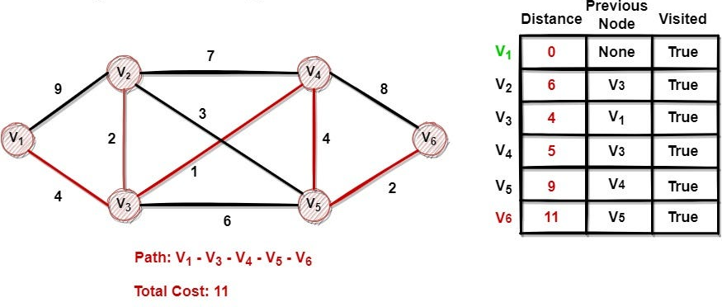
Dijkstra’s Algorithm

Slide 7
Bellman–Ford Algorithm
Bellman–Ford finds shortest path even with negative weights.
Example
A → B (4)
A → C (2)
C → D (-3)
D → B (1)
Advantage
Works with negative weights.

Slide 8
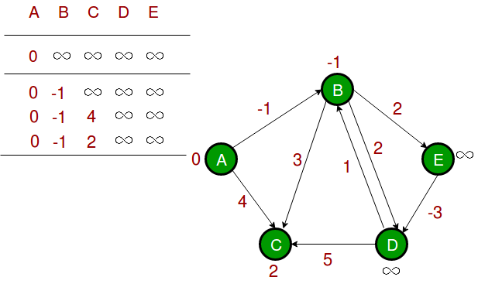
Bellman–Ford Algorithm

Slide 9
Topological Sorting (DAG)
Topological sorting is ordering of vertices in Directed Acyclic Graph (DAG).
Used in task scheduling.
Example
Task A → Task B → Task D
→ Task C →
Possible order:
A → B → C → D

Slide 10
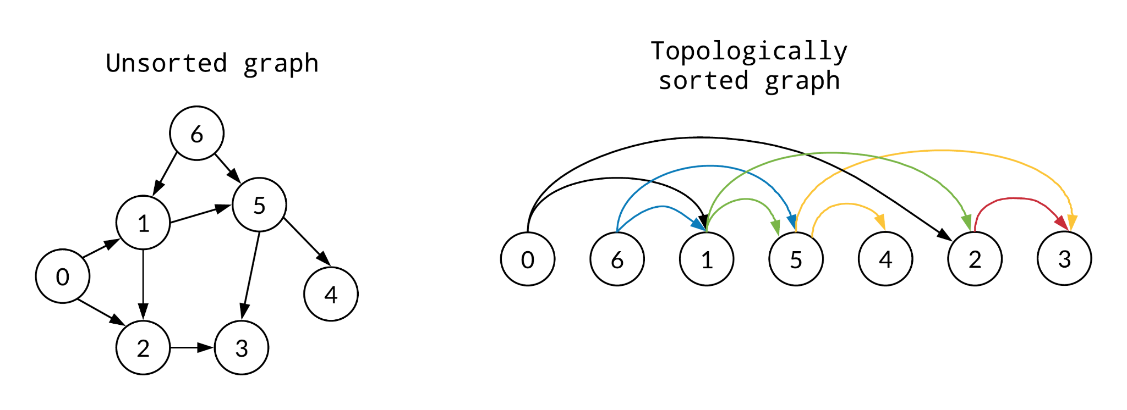
Topological Sorting (DAG)

Slide 11
Minimum Spanning Tree (MST)
Minimum Spanning Tree connects all vertices with minimum total weight and no cycles.
Example
A --1-- B
| /
4 2
| /
C
MST cost = 1 + 2 = 3

Slide 12
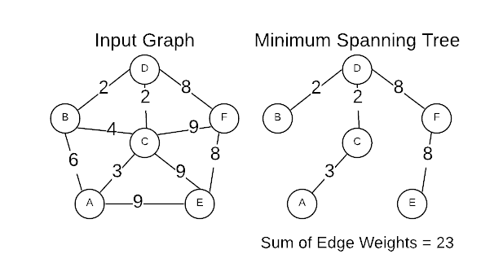
Minimum Spanning Tree (MST)

Slide 13
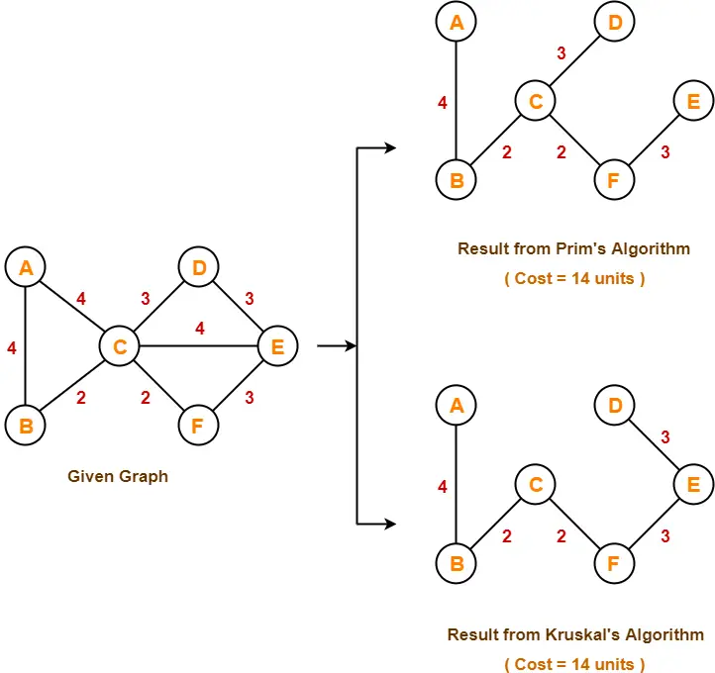
Prim’s Algorithm
Build MST by selecting smallest edge from visited nodes.

Slide 14
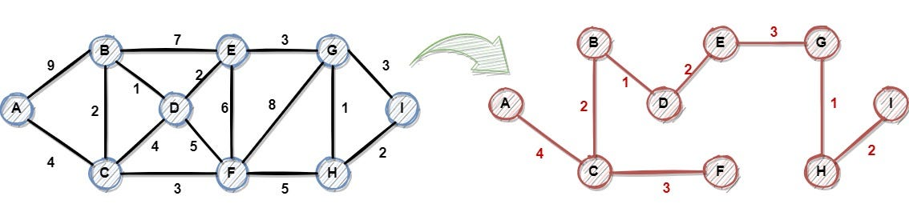
Kruskal’s Algorithm
Select smallest edges without forming cycle.
Example
Edges sorted:
A-B (1)
B-C (2)
A-C (4)
Select:
A-B, B-C

Slide 15
Introduction to Network Flow
Network Flow finds maximum flow from source to destination.
Example:
Water flowing through pipes.
Source → A → B → Sink
Each edge has capacity.

Slide 16
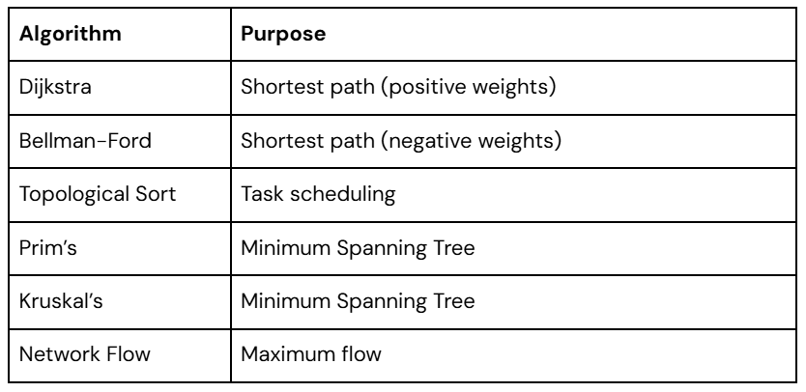
Algorithm Comparison

Slide 17
Key Outcomes
Understand graph optimization concepts
Implement Dijkstra’s Algorithm for shortest path
Implement Bellman–Ford Algorithm
Perform Topological Sorting for task scheduling
Understand Minimum Spanning Tree concept
Implement Prim’s and Kruskal’s Algorithms
Understand basic Network Flow concepts
Apply graph optimization algorithms to real-world problems

Slide 18
Thank You!

